Slide 1
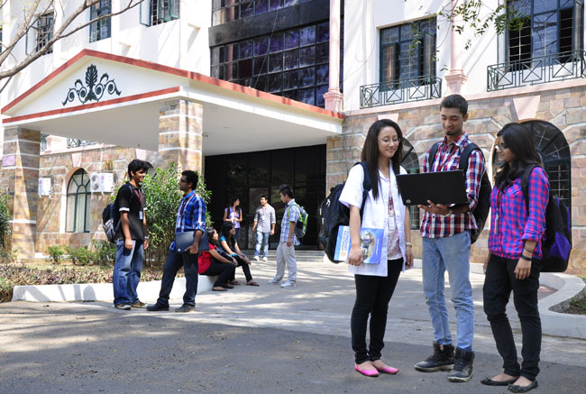

CSB4301 - WEB TECHNOLOGY
B.Tech – V Semester
Dr. Muthukumaran M
School of Computing Sciences,
Department of Computer Science and Engineering

Slide 2
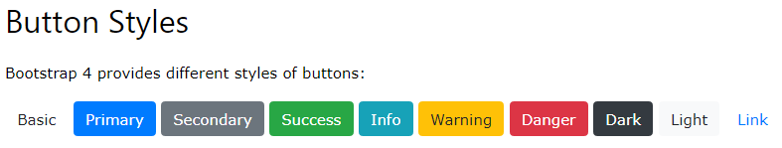
Bootstrap 4 - Buttons

Slide 3
Bootstrap 4 Buttons
<button type="button" class="btn">Basic</button> <button type="button" class="btn btn-primary">Primary</button> <button type="button" class="btn btn-secondary">Secondary</button> <button type="button" class="btn btn-success">Success</button> <button type="button" class="btn btn-info">Info</button> <button type="button" class="btn btn-warning">Warning</button> <button type="button" class="btn btn-danger">Danger</button> <button type="button" class="btn btn-dark">Dark</button> <button type="button" class="btn btn-light">Light</button> <button type="button" class="btn btn-link">Link</button>

Slide 4
Bootstrap 4 Buttons
<!DOCTYPE html>
<html lang="en">
<head>
<title>Bootstrap Example</title>
<meta charset="utf-8">
<meta name="viewport" content="width=device-width, initial-scale=1">
<link rel="stylesheet" href="https://maxcdn.bootstrapcdn.com/bootstrap/4.5.0/css/bootstrap.min.css">
<script src="https://ajax.googleapis.com/ajax/libs/jquery/3.5.1/jquery.min.js"></script>
<script src="https://cdnjs.cloudflare.com/ajax/libs/popper.js/1.16.0/umd/popper.min.js"></script>
<script src="https://maxcdn.bootstrapcdn.com/bootstrap/4.5.0/js/bootstrap.min.js"></script>
</head>
<body>
<div class="container">

Slide 5
Bootstrap 4 Buttons
<h2>Button Styles</h2>
<button type="button" class="btn">Basic</button>
<button type="button" class="btn btn-primary">Primary</button>
<button type="button" class="btn btn-secondary">Secondary</button>
<button type="button" class="btn btn-success">Success</button>
<button type="button" class="btn btn-info">Info</button>
<button type="button" class="btn btn-warning">Warning</button>
<button type="button" class="btn btn-danger">Danger</button>
<button type="button" class="btn btn-dark">Dark</button>
<button type="button" class="btn btn-light">Light</button>
<button type="button" class="btn btn-link">Link</button>
</div>
</body>
</html>

Slide 6
Bootstrap 4 Buttons
The button classes can be used on <a>, <button>, or <input> elements:
Example
<a href="#" class="btn btn-info" role="button">Link Button</a> <button type="button" class="btn btn-info">Button</button> <input type="button" class="btn btn-info" value="Input Button"> <input type="submit" class="btn btn-info" value="Submit Button">

Slide 7
Button Outline
Bootstrap 4 provides eight outline/bordered buttons:

Slide 8
Button Outline
<button type="button" class="btn btn-outline-primary">Primary</button> <button type="button" class="btn btn-outline-secondary">Secondary</button> <button type="button" class="btn btn-outline-success">Success</button> <button type="button" class="btn btn-outline-info">Info</button> <button type="button" class="btn btn-outline-warning">Warning</button> <button type="button" class="btn btn-outline-danger">Danger</button> <button type="button" class="btn btn-outline-dark">Dark</button> <button type="button" class="btn btn-outline-light text-dark">Light</button>

Slide 9

Button Sizes
Use the .btn-lg class for large buttons or .btn-sm class for small buttons:

Slide 10
Button Sizes
<button type="button" class="btn btn-primary btn-lg">Large</button> <button type="button" class="btn btn-primary">Default</button> <button type="button" class="btn btn-primary btn-sm">Small</button>

Slide 11
Block Level Buttons
Add class .btn-block to create a block level button that spans the entire width of the parent element.

Slide 12
<button type="button" class="btn btn-primary btn-block">Full-Width Button</button>

Slide 13

Active/Disabled Buttons
A button can be set to an active (appear pressed) or a disabled (unclick able) state:
Active Primary & Disabled Primary
The class .active makes a button appear pressed, and the .disabled attribute makes a button unclick able.
Note that <a> elements do not support the disabled attribute and must therefore use the .disabled class to make it visually appear disabled.

Slide 14
<button type="button" class="btn btn-primary active">Active Primary</button> <button type="button" class="btn btn-primary" disabled>Disabled Primary</button> <a href="#" class="btn btn-primary disabled">Disabled Link</a>

Slide 15

Spinner Buttons
You can also add "spinners" to a button,

Slide 16
<button class="btn btn-primary"> <span class="spinner-border spinner-border-sm"></span> </button> <button class="btn btn-primary"> <span class="spinner-border spinner-border-sm"></span> Loading.. </button>
<button class="btn btn-primary" disabled> <span class="spinner-border spinner-border-sm"></span> Loading.. </button> <button class="btn btn-primary" disabled> <span class="spinner-grow spinner-grow-sm"></span> Loading.. </button>

Slide 17
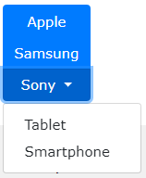

Activity – Use Bootstrap 4 Button Groups to generate following pattern

Slide 18
Bootstrap 4 Basic Table
A basic Bootstrap 4 table has a light padding and horizontal dividers.
The .table class adds basic styling to a table:

Slide 19
<!DOCTYPE html>
<html lang="en">
<head>
<title>Bootstrap Example</title>
<meta charset="utf-8">
<meta name="viewport" content="width=device-width, initial-scale=1">
<link rel="stylesheet" href="https://maxcdn.bootstrapcdn.com/bootstrap/4.5.0/css/bootstrap.min.css">
<script src="https://ajax.googleapis.com/ajax/libs/jquery/3.5.1/jquery.min.js"></script>
<script src="https://cdnjs.cloudflare.com/ajax/libs/popper.js/1.16.0/umd/popper.min.js"></script>
<script src="https://maxcdn.bootstrapcdn.com/bootstrap/4.5.0/js/bootstrap.min.js"></script>
</head>
<body>

Slide 20
<div class="container">
<h2>Basic Table</h2>
<p>The .table class adds basic styling (light padding and horizontal dividers) to a table:</p>
<table class="table">
<thead>
<tr>
<th>Firstname</th>
<th>Lastname</th>
<th>Email</th>
</tr>
</thead>
<tbody>
<tr>
<td>John</td>
<td>Doe</td>
<td>john@example.com</td>
</tr>
<tr>
<td>Mary</td>
<td>Moe</td>
<td>mary@example.com</td>
</tr>
<tr>
<td>July</td>
<td>Dooley</td>
<td>july@example.com</td>
</tr>
</tbody>
</table>
</div>
</body>
</html>

Slide 21
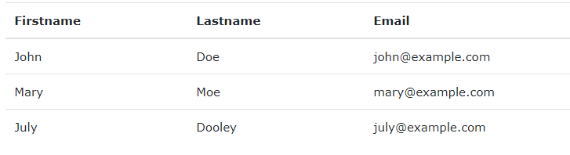
OUTPUT

Slide 22
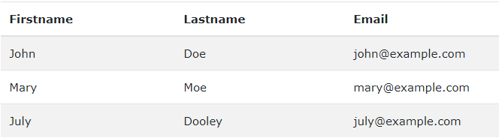
Striped Rows
The .table-striped class adds zebra-stripes to a table:

Slide 23
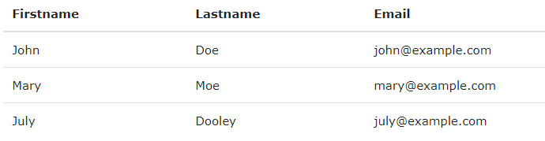
Hover Rows
The .table-hover class adds a hover effect (grey background color) on table rows:

Slide 24
Borderless Table
The .table-borderless class removes borders from the table:
Hoverable Dark Table
The .table-hover class adds a hover effect (grey background color) on table rows:
Dark Striped Table
Combine .table-dark and .table-striped to create a dark, striped table:

Slide 25
Bootstrap 4 Progress Bars
Basic Progress Bar
A progress bar can be used to show a user how far along he/she is in a process.
To create a default progress bar, add a .progress class to a container element and add the .progress-bar class to its child element. Use the CSS width property to set the width of the progress bar:

Slide 26
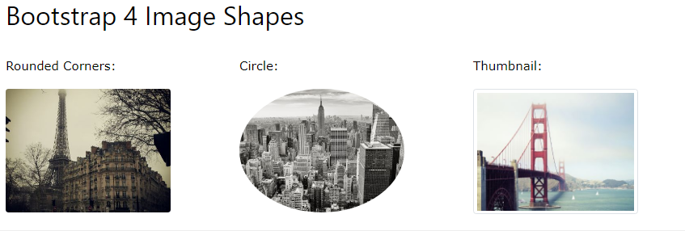

Slide 27
Rounded Corners
The .rounded class adds rounded corners to an image:
Example
<img src="cinqueterre.jpg" class="rounded" alt="Cinque Terre">

Slide 28
Circle
The .rounded-circle class shapes the image to a circle:
Example
<img src="cinqueterre.jpg" class="rounded-circle" alt="Cinque Terre">

Slide 29
Thumbnail
The .img-thumbnail class shapes the image to a thumbnail (bordered):
Example
<img src="cinqueterre.jpg" class="img-thumbnail" alt="Cinque Terre">

Slide 30
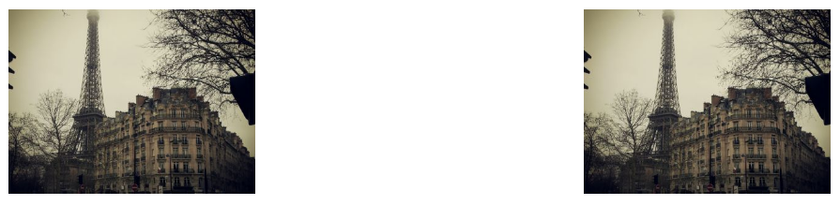
Aligning Images
Float an image to the right with the .float-right class or to the left with .float-left:
Example
<img src="paris.jpg" class="float-left"> <img src="paris.jpg" class="float-right">

Slide 31
Mini Project
Create a responsive webpage, about you using HTML tags and CSS3 Components.
Main Includes:
Display your Image and when the mouse is moved over the image, then any common photo should be shown and then again if mouse is moved off the image, your own picture has to be displayed.
Include Transitions and Transformations .
Include minimum of three navigations using “href” attribute, to other webpages like academic details, co-curricular activities and personal details.
Use CSS Color Codes and Styles to the web page.

